Slide 1
ECE 445 Overview and RFA Process
Prof. Arne Fliflet (afliflet@illinois.edu)
Prof. Viktor Gruev( vgruev@illinois.edu)
Prof. Jonathan Schuh (schuh4@illinois.edu)
Notes:
ECE Main Slide

Slide 2
Today’s Agenda
4:00 Welcome and Overview and RFA
4:40 Conflict management workshop
5:20 Break
5:25 Pitch Projects
5:40 Brainstorming

Slide 3

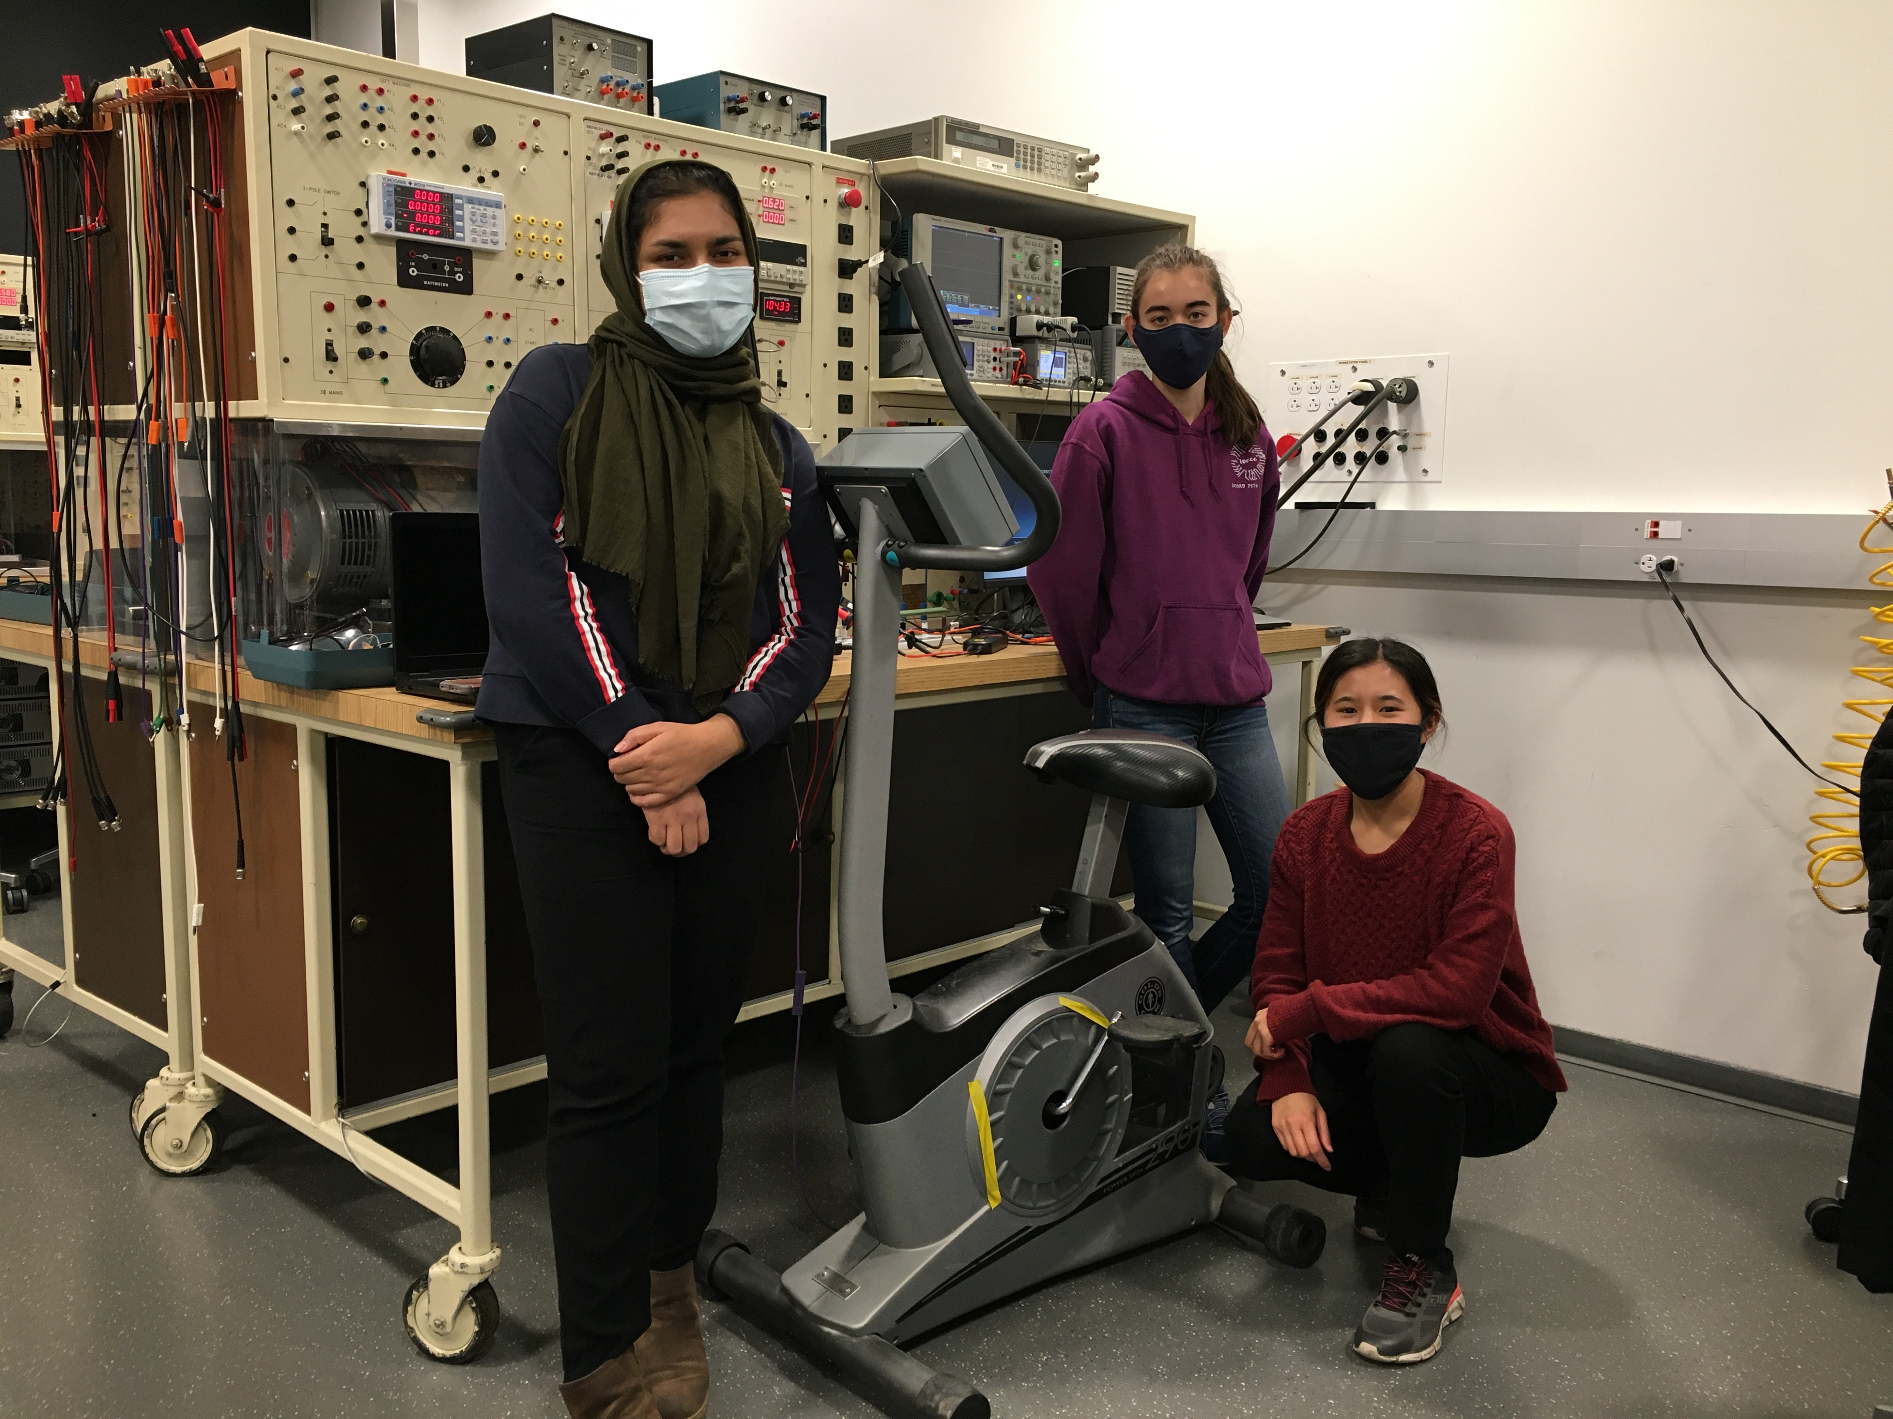
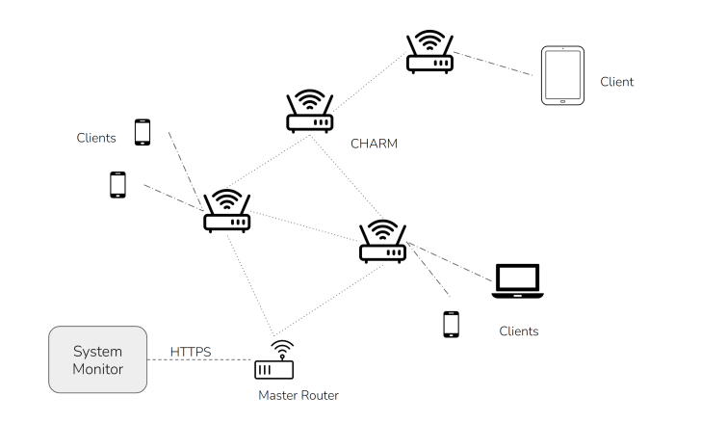
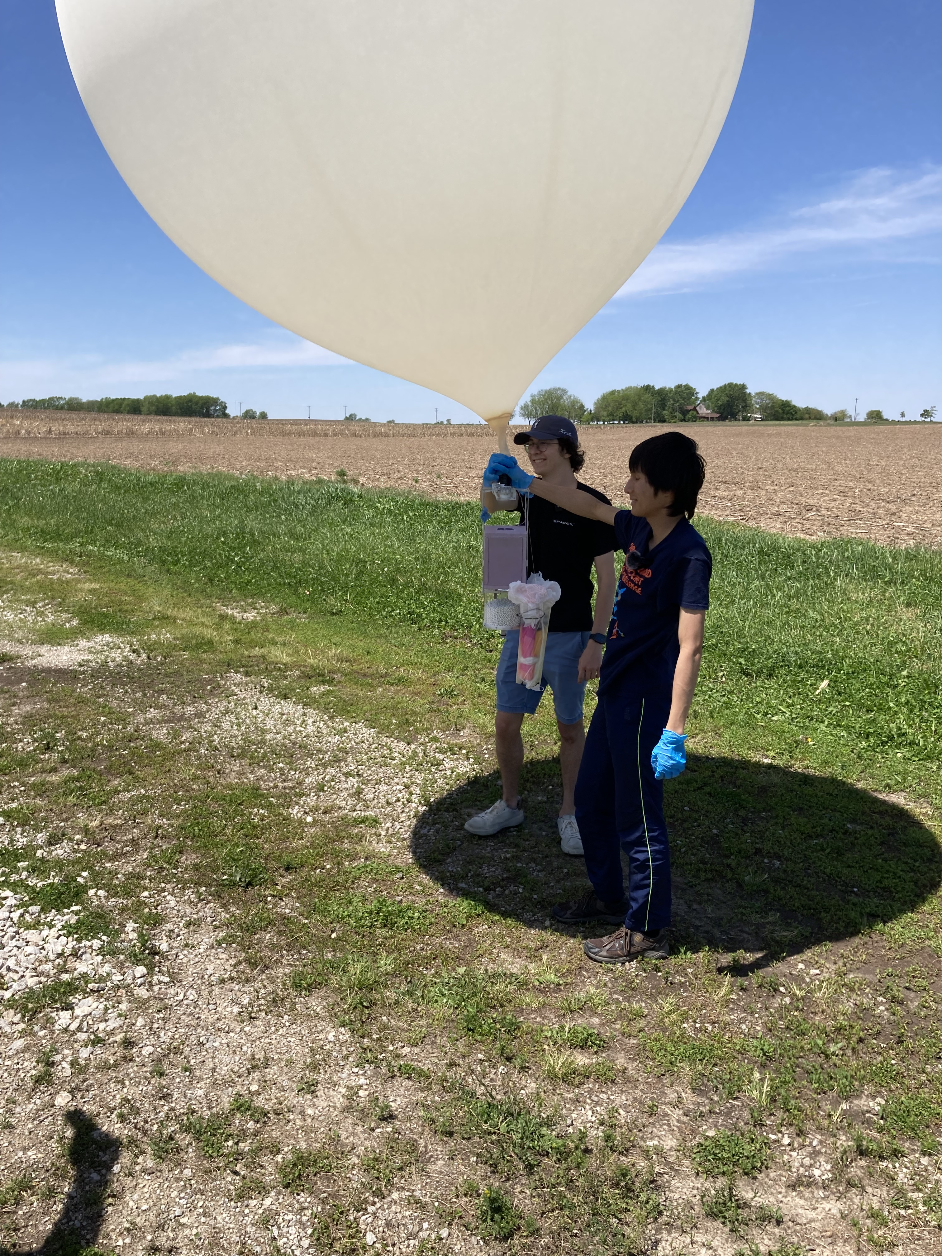
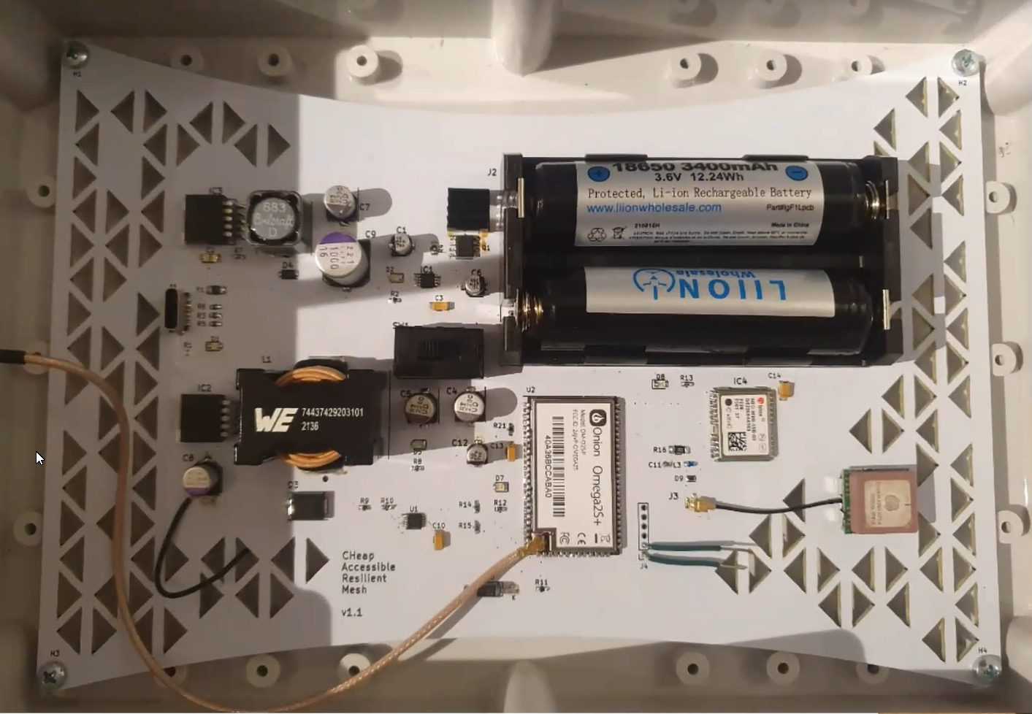
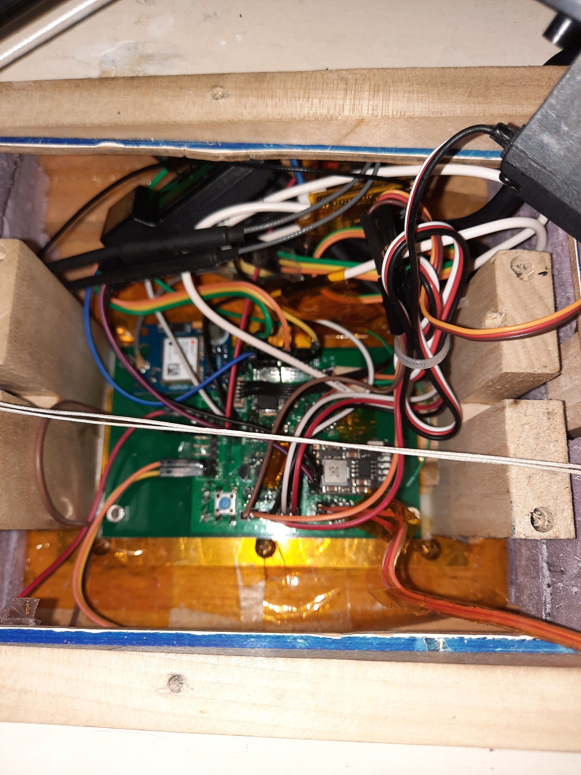
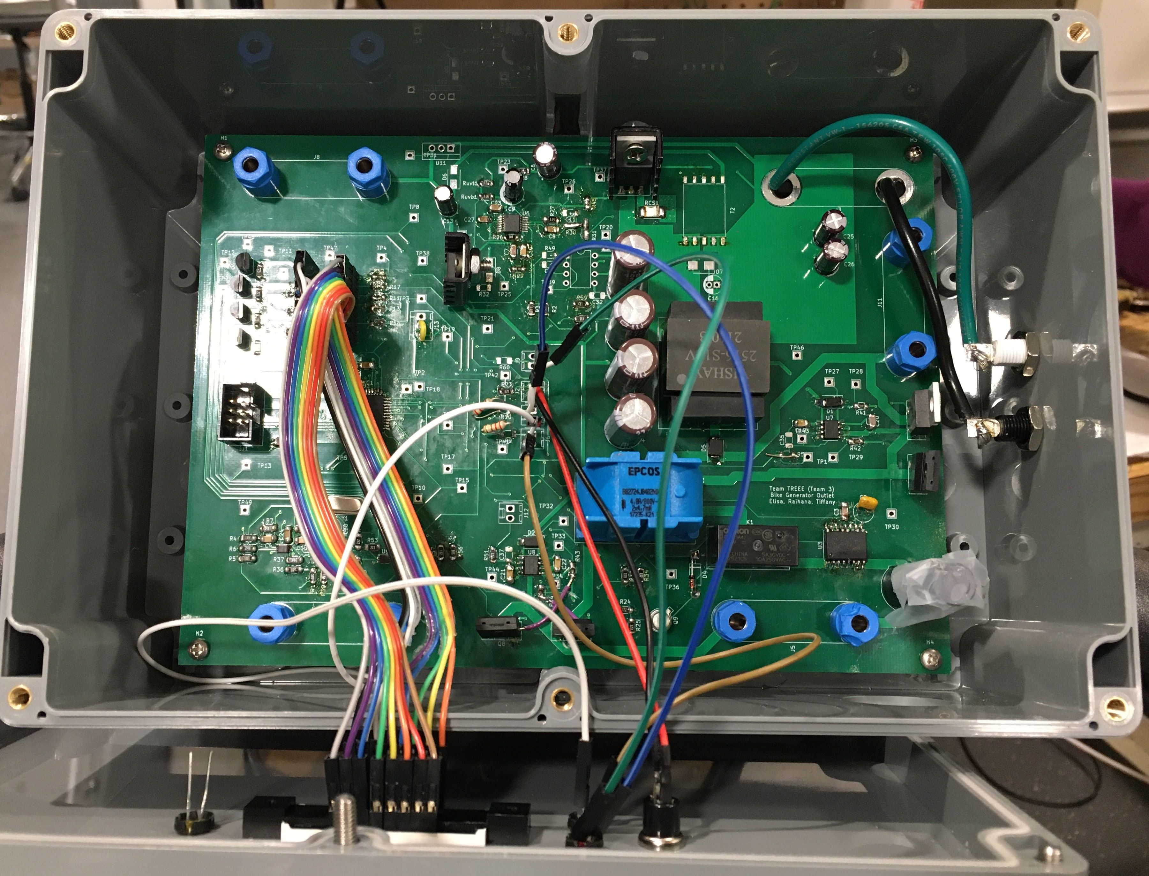
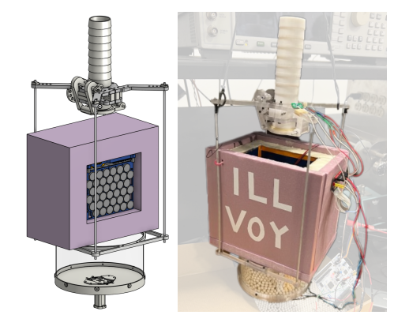
Introduction
Welcome to ECE 445, Senior Design Project Laboratory, the department’s capstone course
We expect you to carry out projects that are unique, technically challenging, and completable within the semester.
Illini Voyager (SP23)
CHARM (FA22)
Autonomous Sailboat (SP22)
Grid-tied Spin Bike (FA21)
Notes:
A capstone course means it is a demonstration of your newly acquired capabilities as electrical and computer engineers
Think about the courses you found particularly interesting
How could the material be used to solve an interesting problem?
We want you to come up with novel solutions to problems
There needs to be a sufficient amount of complexity
Here has to be an EE element to the project
Project needs to be compatible with time and resource constraints
We fully expect that you will undertake challenging projects
One of the best parts of teaching this course comes at the end when we have to decide on which are the best projects
The slide shows some recent successful projects.
The Illini Voyager was a balloon project that had as it’s objective to avoid gaining altitude until it popped, which is the normal fate of such balloons. It was quite successful and was recovered in West Virginia after being launched in Champaign.
CHARM: CHeap Accessible Resilient Mesh for Remote Locations and Disaster Relief. The objective was to create a set of meshing, cheap, lightweight, and self-contained wireless internet access points, deployable via drone. The project was successfully demonstrated on the quad outside and included a half-dozen well-engineered PCBs.
Autonomous Sailboat: The objective of this project was to add an autonomous sailing capability to an RC model sailboat. The idea was to enable the sailboat to sail itself in any direction for a given wind direction by means of an electronic compass and windvane. The project was quite successful and included a return to base feature. The boat is still available if anyone want to try this project again.
Grid-tied Spin Bike: The objective was to demonstrate that the human energy expended while exercising on spin bikes can be processed and injected into the grid to reduce energy costs. Were able to generate a10 W ac signal phase-locked to the local grid.

Slide 4
Course Overview
Introductory lectures, Q&A sessions, and class exercises (weeks 1-4)
Project identification and team formation (weeks 1-3)
  Propose a project idea or respond to a project pitch on the class web board
  Form a project team
  Prepare a Request For Approval (RFA)
  Approved projects are assigned a TA and instructor
Microencabulator PCB training assignments (weeks 1-3)
  Learn to use KICAD to design a microprocessor-based PCB ready for fabrication
  Solder components onto this PCB, download software, and demo operation
Project Proposal and Design Document (weeks 4-6)
  The proposal is a plan for your project and its prescribed structure basically determines how you will describe and characterize your project.
  After finishing the proposal teams further develop their project plan in the Design Document which is essentially a manual for completing the project.
  The design documents are presented by the teams to the instructors and TA at the Design Review and receive final project go-ahead.
Project fabrication, testing and analysis (weeks 7-14)
Demo, Final Presentation and Final Report (weeks 15-16)

Slide 5
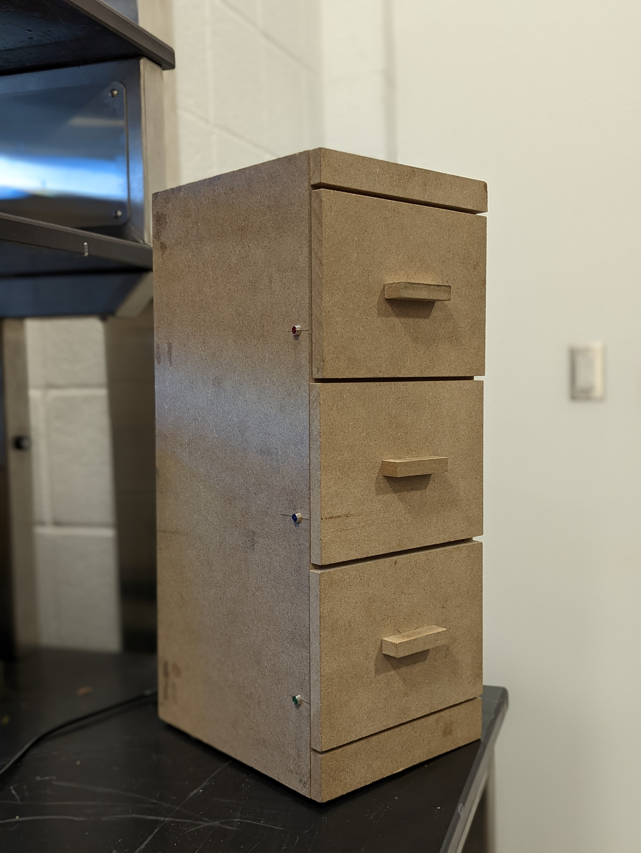
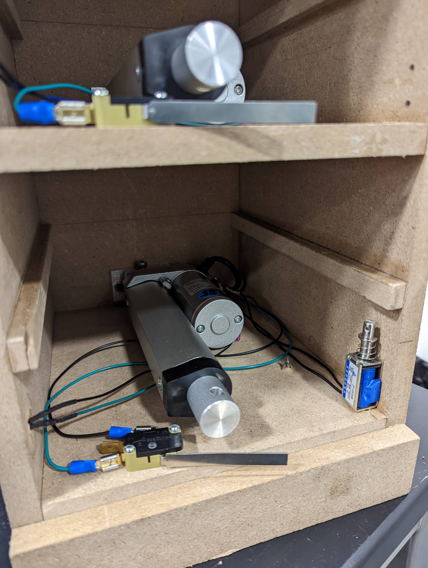
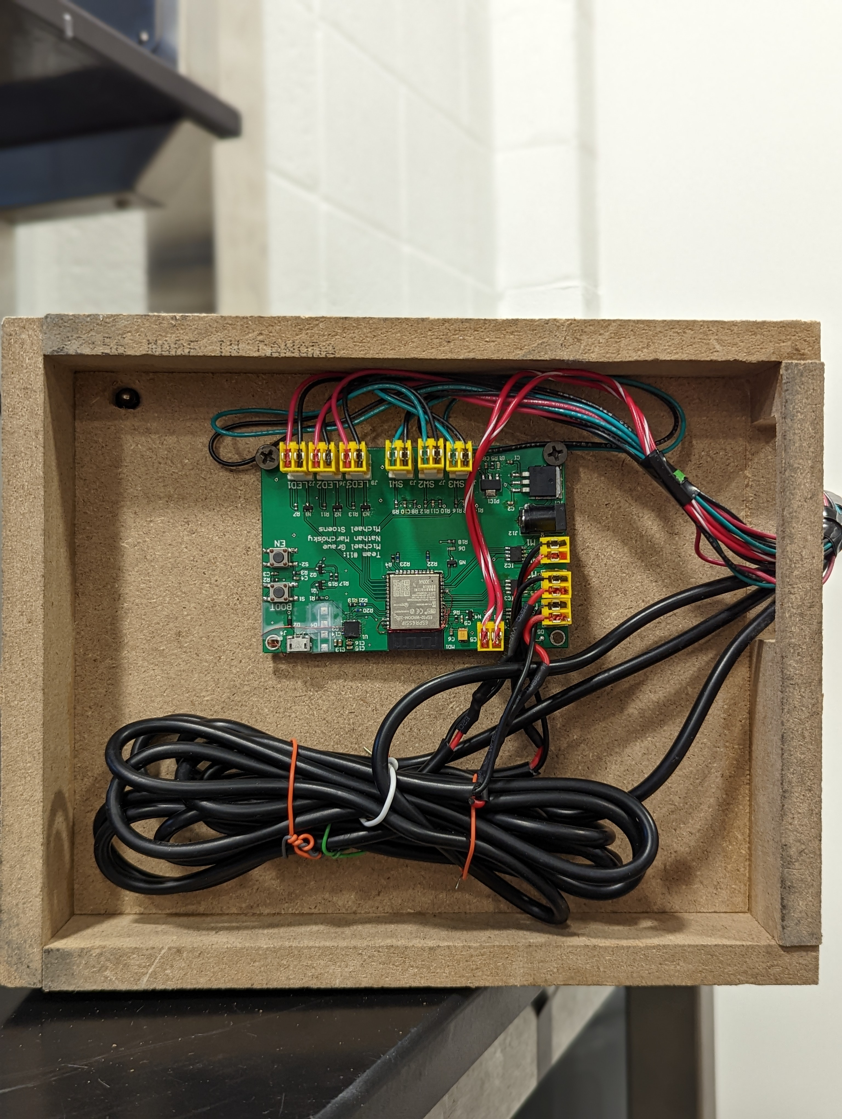
Example: Smartphone Controlled Drawer Organization System
This project was novel, included a custom PCB with a microcontroller, and was completable within the time constraints of the course.
Notes:
Point out machine shop as a resource. Keep physical design simple

Slide 6
PCB Training (weeks 1-3)
To help you have a successful PCB experience, you will have a two-part PCB training assignment during the first three weeks of the course.
CAD Assignment: Use KiCAD to design a simple PCB for a Microencabulator. A tutorial is provided. End results are the Gerber files used in PCB fabrication
Soldering Assignment: You are given the Microencabulator PCB and solder the circuit components onto the board. You then download the Microencabulator program to the MCU, do the final assembly and demonstrate the device function

Slide 7
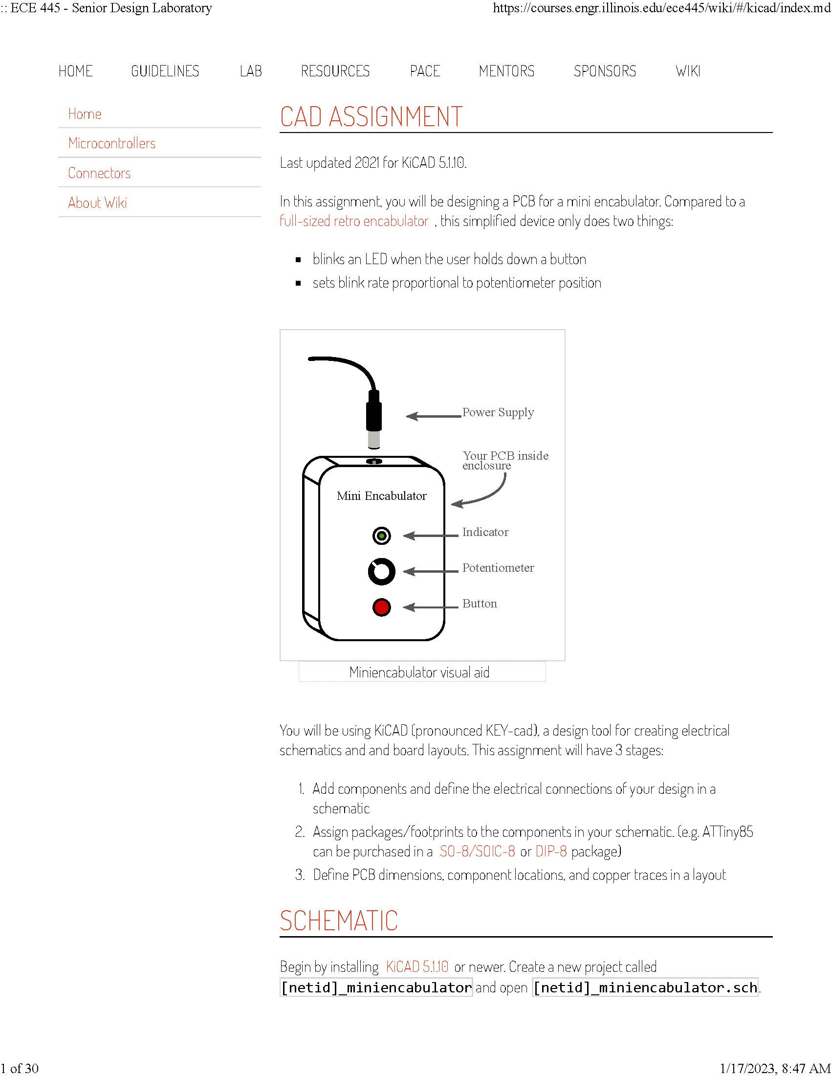
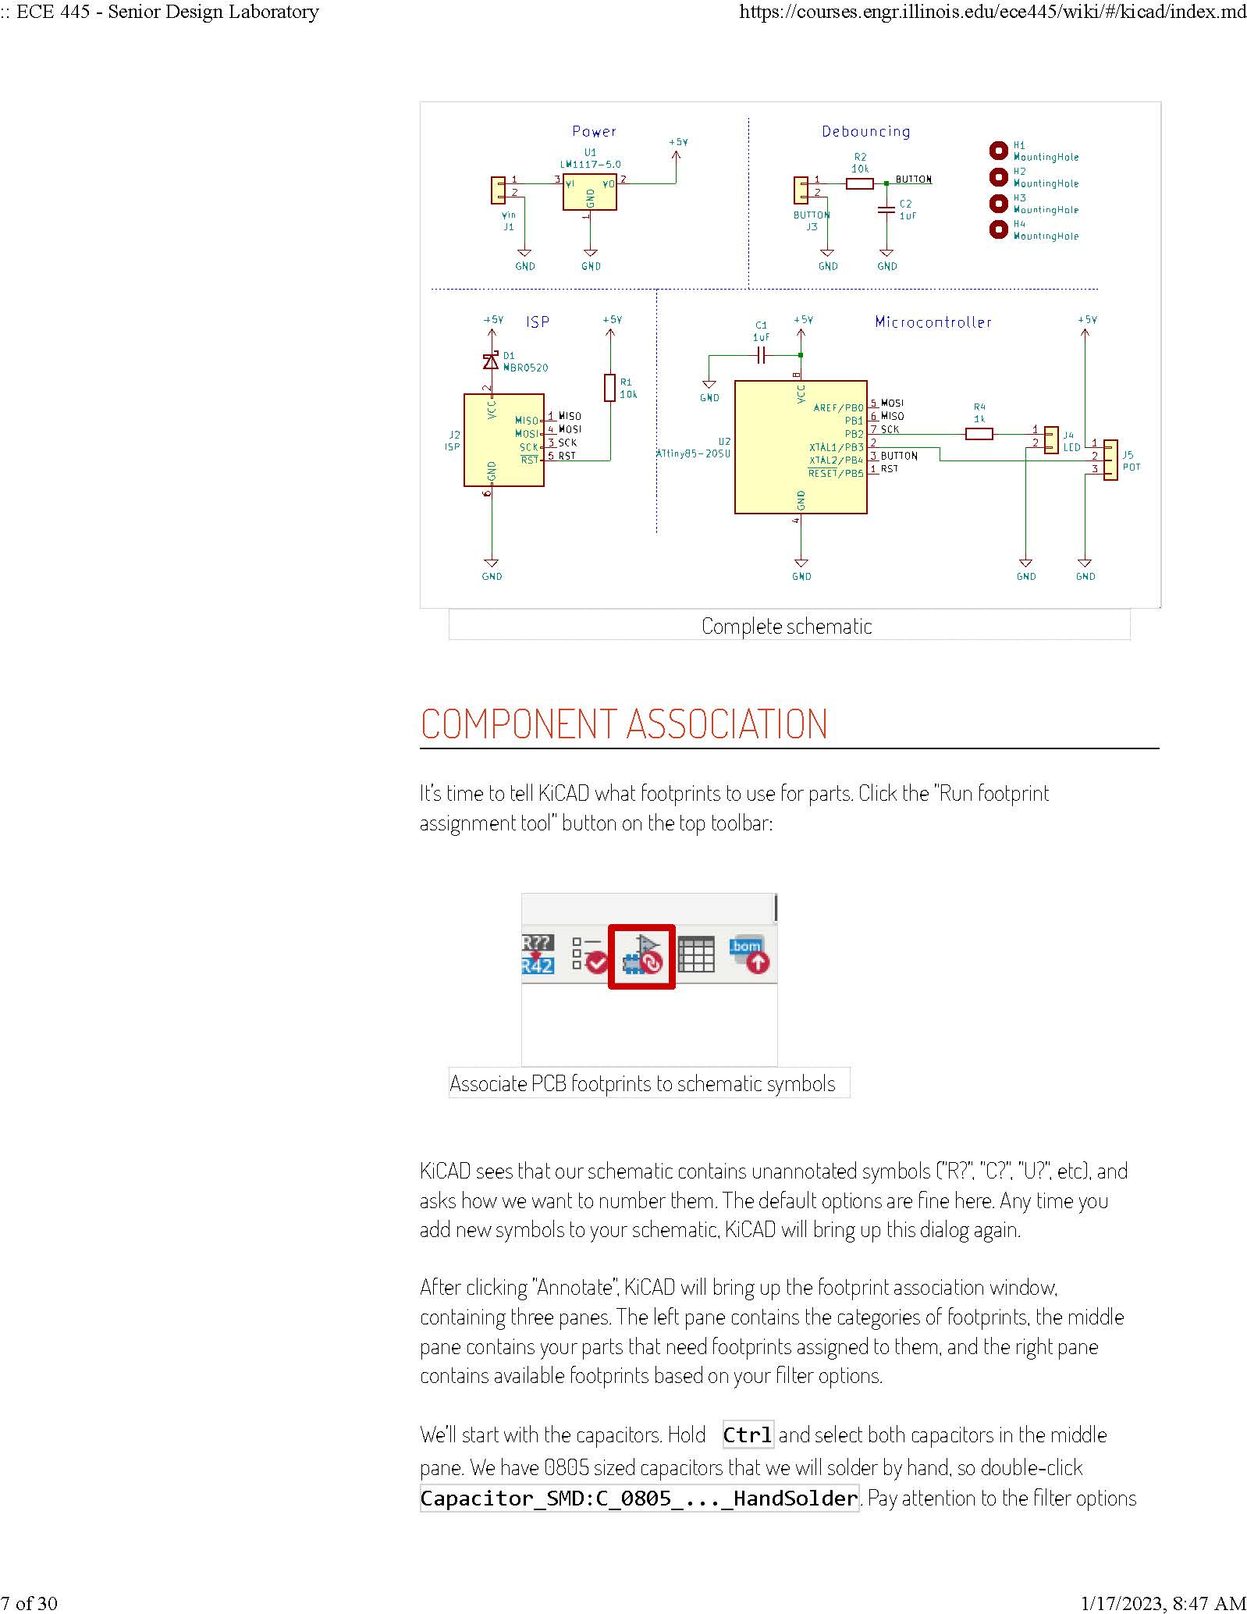
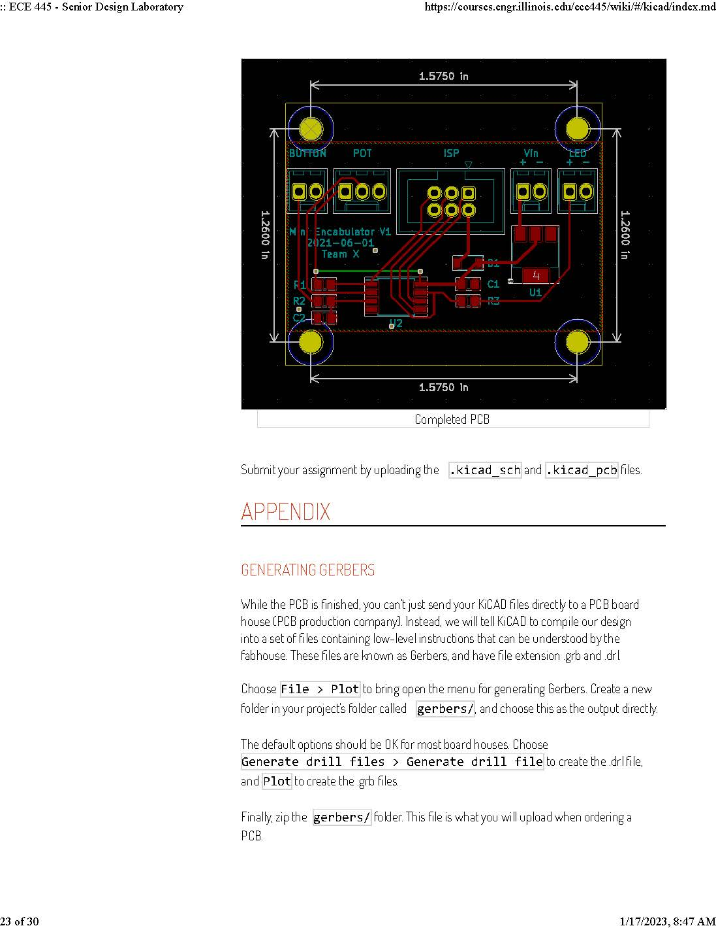
CAD Assignment

Slide 8
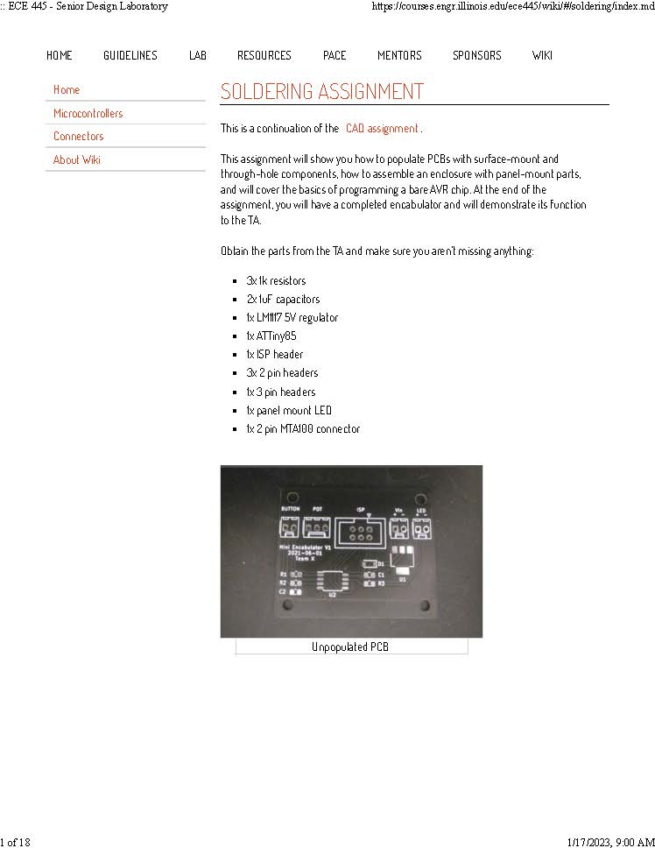
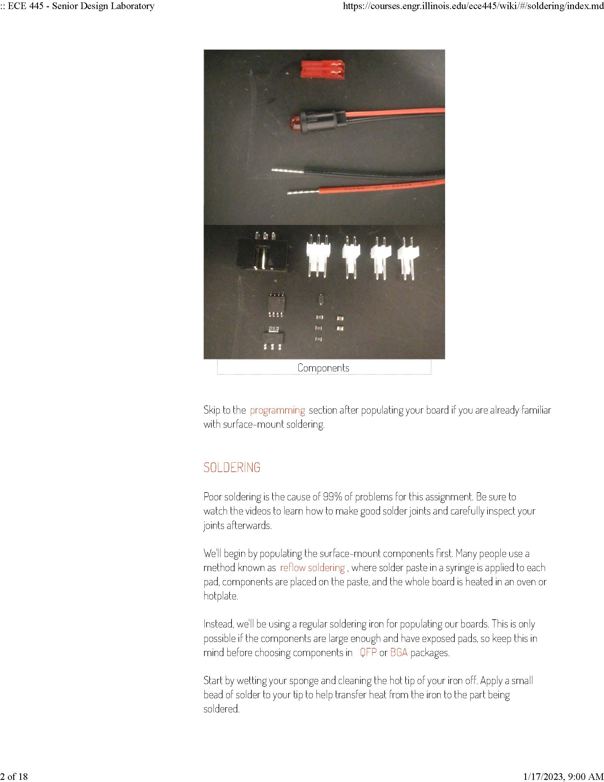
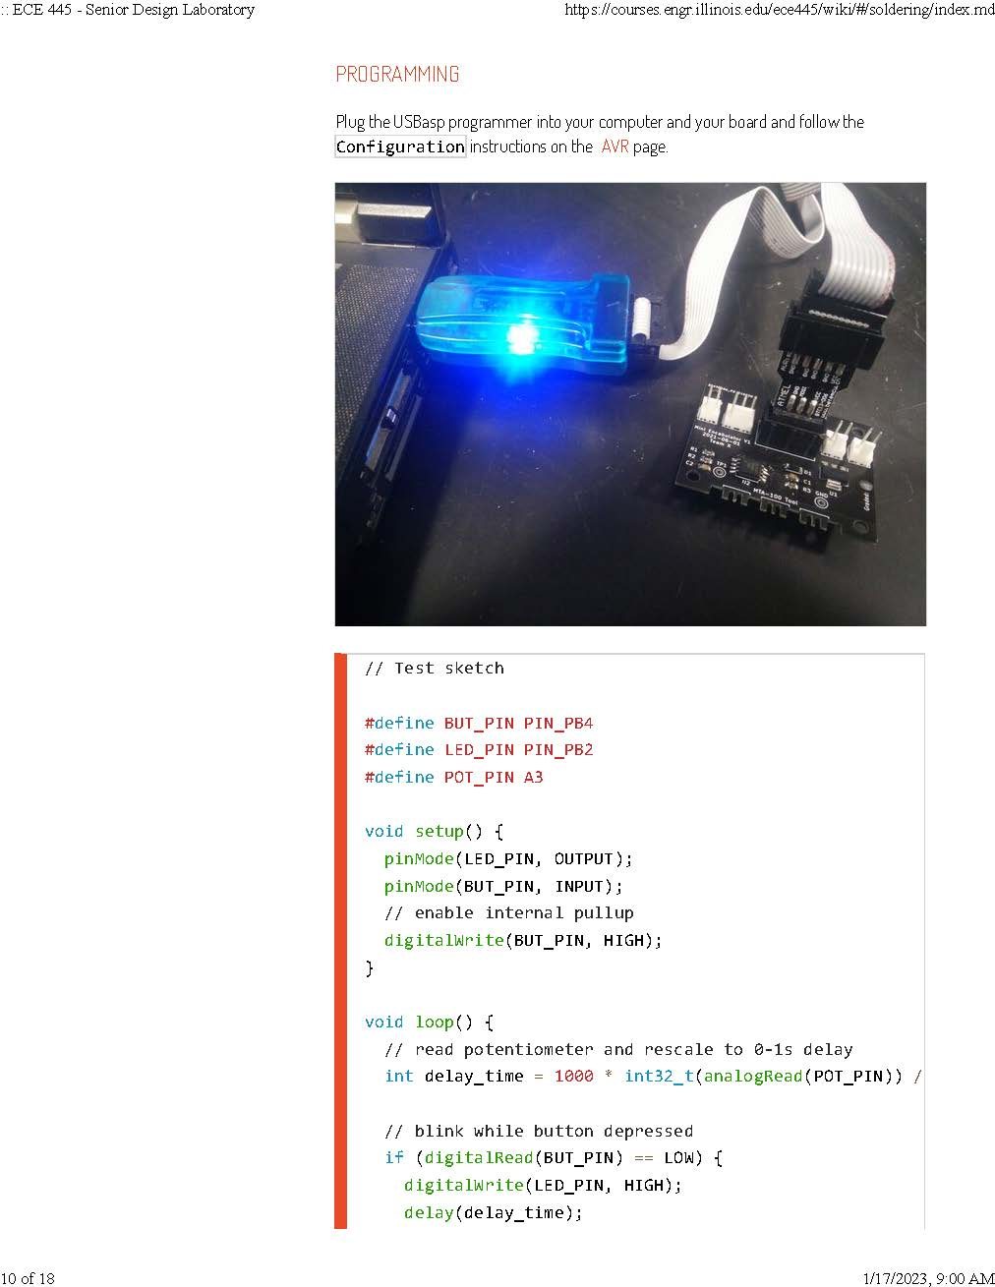
Soldering Assignment

Slide 9
Preparing an RFA

Slide 10
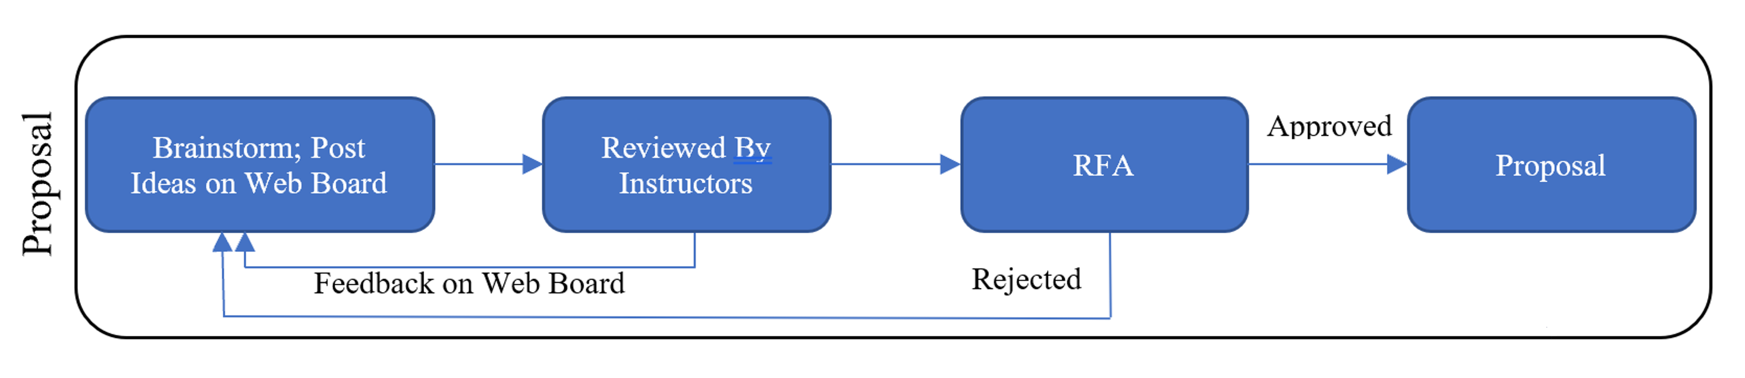
Importance of the RFA
The RFA sets the goal to work on during the semester
Getting project approved early will give you extra time to design, build and research
Defining the right scope in the RFA will help you balance work and life during the stressful semester
It’s the first team assignment of the course, so an opportunity to build your teamwork skills (teams of 3)

Slide 11
!!!!! Consequences of lagging behind !!!!!
!!!! and resources for seeking help !!!!!
If you haven’t got project approved by the 3rd week…
  Although you seem to have only lost 5/~500 points…
  You will have little time left to get an RFA approved, and the proposal is due in the 4th week, worth 25 /~500 points
  The effect is progressive, time for later tasks will be shortened
If you haven’t got project approved by the 3rd week…
  Talk to TAs and professors to clarify the scope (use office hours)
  Talk to different project sponsors
  Join approved teams
  We will help you succeed but don’t wait until the last minute

Slide 12
Project Ideas
Best Practices

Slide 13
Define the Problem
“A problem well-stated is a problem half-solved.” ~ Charles Kettering
Motivate your problem (i.e. why should we care?)
Limit scope and restrict focus
  Be mindful of the course schedule and available resources
When is the problem solved?
  You satisfy all defined sensible constraints
  You show improvement over previous efforts to solve the problem

Slide 14
Solve the Problem
Be aware of alternatives, and re-evaluate your design regularly
  Is there a better or more efficient way to accomplish your project’s goals?
  Can your problem be solved without using ECE approaches?
  Are you using the best sensors for the job?
  Is a good commercial solution already available?
Solve the problem elegantly
  Make your solution modular
  Do not solve a simple problem in a complicated way

Slide 15
Project Complexity (Soft Rules)
Things we are looking for:
  Printed Circuit Board
  MCU or FPGA
  Actuator and Sensors
  Application of Course Knowledge
circuit implementation
software implementation
mathematical analysis (signal processing, control theory, EM, etc…)
Projects are evaluated based on your background
  What background knowledge and experience do you have?
  Are you gaining new knowledge and skills during this course?

Slide 16
Submit an Idea

Slide 17
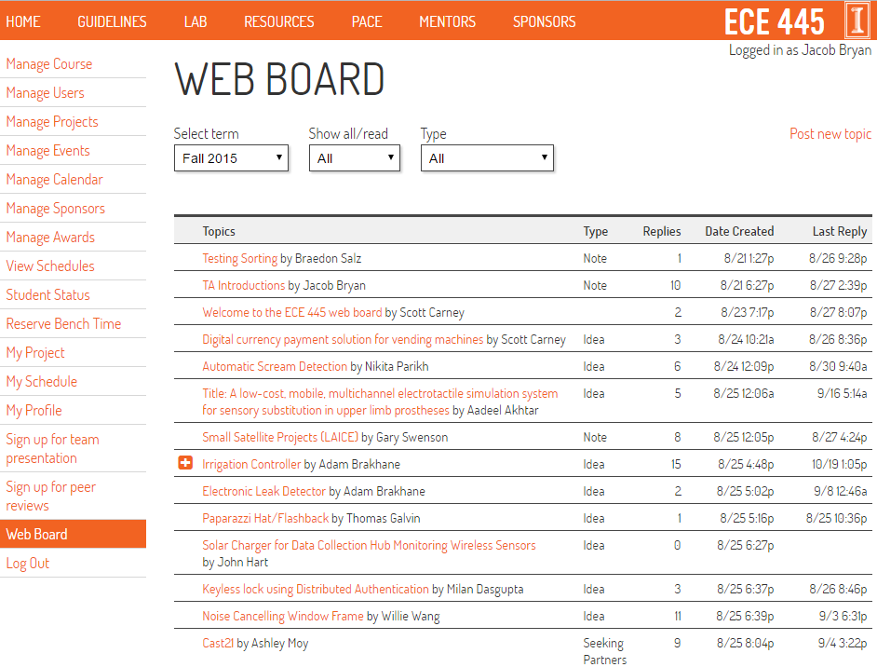
Step 1: Post an idea to the Web Board
Click on

Slide 18
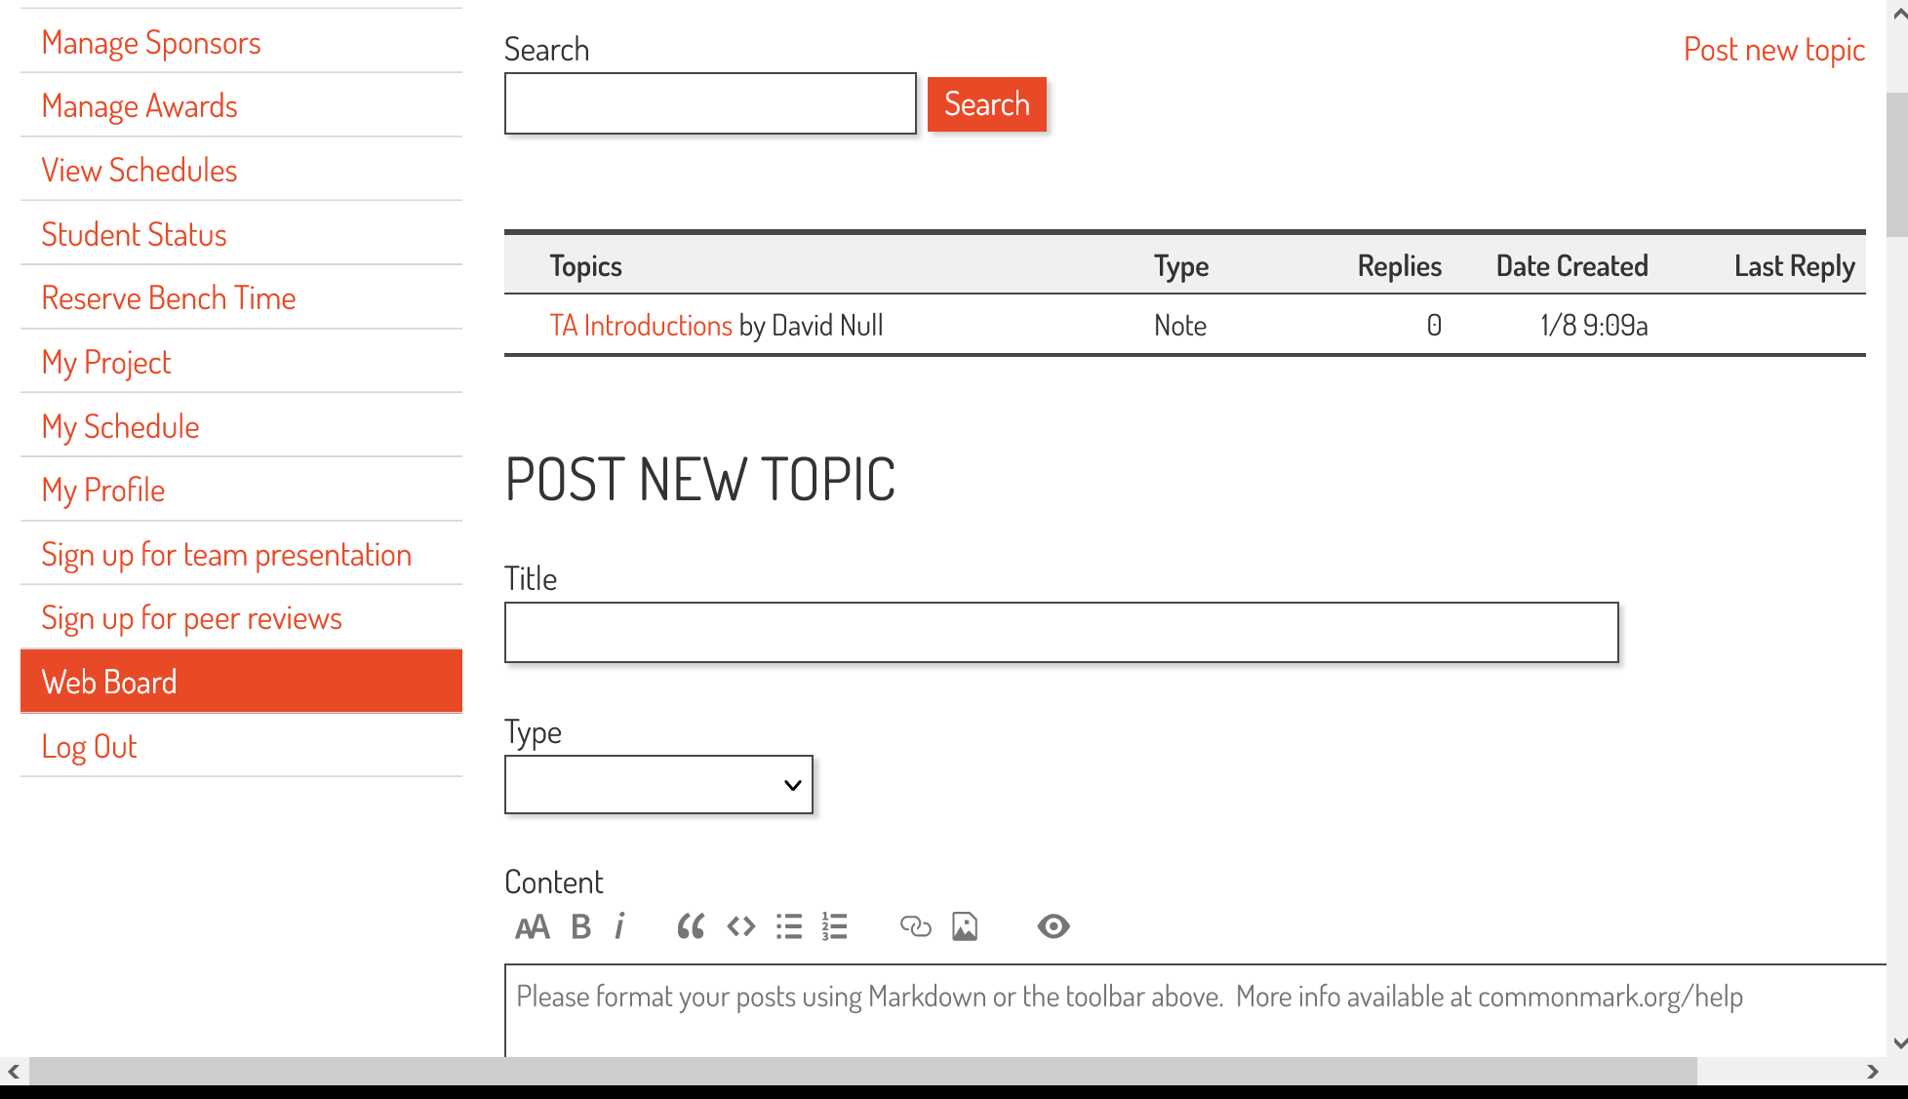
Step 1: Post an idea to the Web Board, cont’d
Describe your idea here

Slide 19
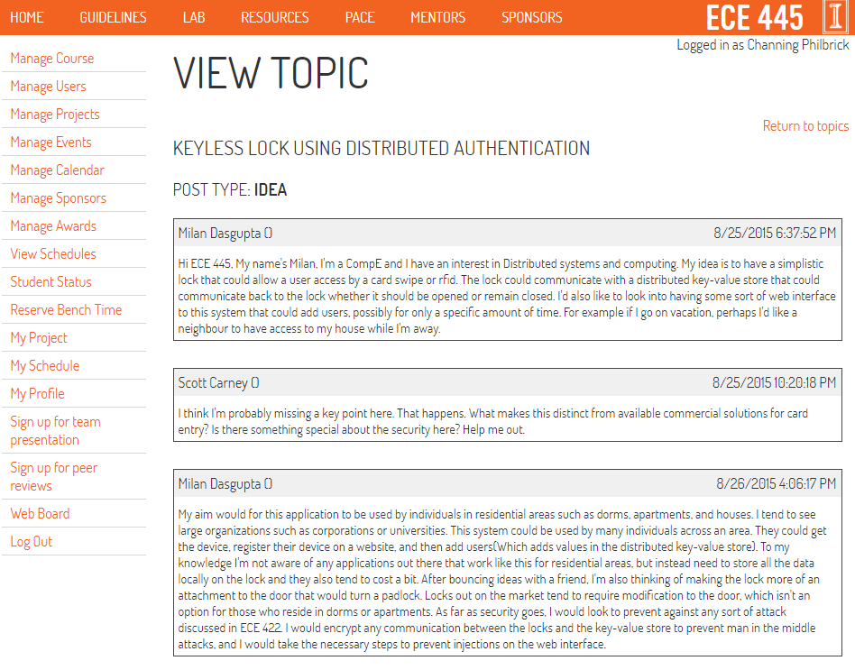
Step 2: Respond to feedback

Slide 20
Submit an RFA

Slide 21
RFA Template
Problem
Solution Overview
Solution Components
  Component 1
  Component 2
  Etc.
Criterion for Success

Slide 22
Example RFA
Problem
  Theme parks, airports, hotels, libraries, corporations, etc., all have general ideas of how many people are on their premises throughout the day or year but they do not know the instantaneous count of people over that area. Better estimates can improve traffic and resource management.
Solution Overview
  Our solution for accurately counting individuals entering or exiting an area is a portable battery-powered device which can be mounted above a door frame. It uses ultrasonic and infrared sensors to count individuals crossing the door threshold.

Slide 23
Example RFA (cont.)
Solution Components
Sensor Subsystem
- Passive infrared sensors for detecting a human being about
to cross a doorway and trigger ultrasonic sensors
- Ultrasonic sensors for detecting the heights of individuals,
whether they are entering or exiting, and determining whether
multiple people are crossing the threshold simultaneously
We will use different frequency ultrasonic sensors focused at different angles to gain topology information at different locations simultaneously.

Slide 24
Example RFA (cont.)
Processing Subsystem
- Internal microcontroller for A/D conversion and initial signal
processing (Atmel atmega328)
- Bluetooth or Zigbee to send data from microcontroller to
external server
Power Subsystem
- Converts standard AC outlet power to required DC voltages for
charging batteries, and for sensors, microcontroller, and
communications module demands

Slide 25
Example RFA (cont.)
Criterion for Success
  Our solution can accurately count groups of people crossing a doorway simultaneously, report counts to a remote server, and last at least one day on batteries.
Alternatives
  SensorInsight currently provides a camera-based solution for watching crowds flows over a wide area. Our solution is different because we focus on precisely counting people entering or exiting an area. We seek to build a much cheaper solution than one of SensorInsight’s high-definition cameras with our mixed sensor module.

Slide 26
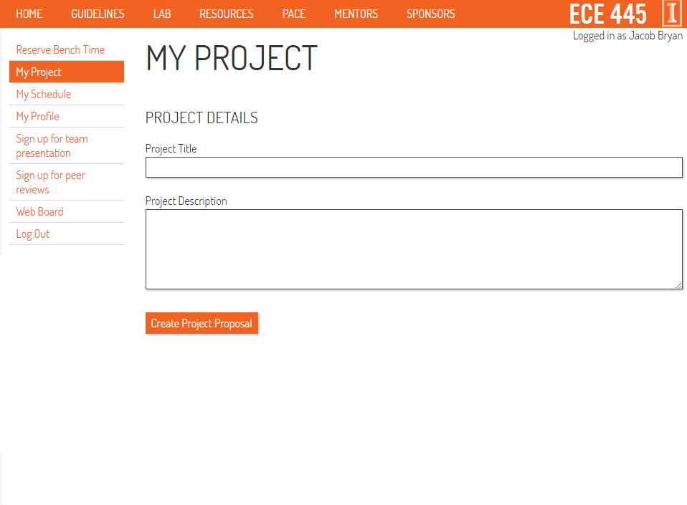
Step 1: Submit the RFA

Slide 27
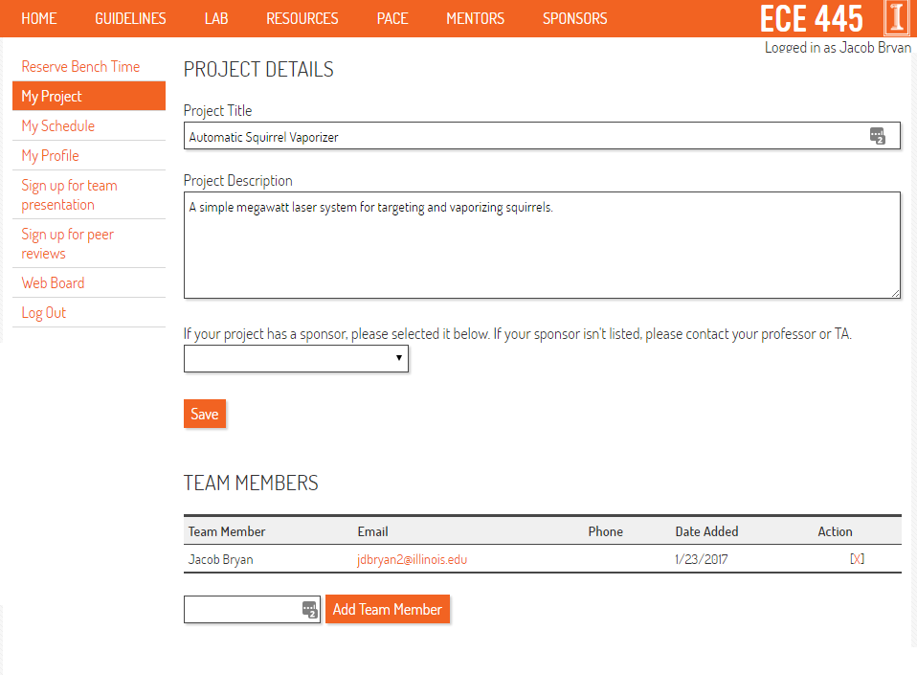
Step 2: Submit the RFA

Slide 28
Step 3: Incorporate Feedback
The staff will give you feedback
  Update your RFA from the My Project page
  Check for feedback frequently
  Respond to your feedback early
Please submit one RFA at a time for your most promising idea
  You can have multiple ideas under discussion
Go to office hours for in-depth discussion of project
Project Rejected
  Try, try again…
Project Approved
  Start working on your Proposal Immediately

Slide 29
Expectations for Idea and RFA posts
Similarities | Idea | RFA
 | May work from a project pitch in collaboration
 | May use previous ideas and proposals as inspiration for improvement
 | Do not use previous semesters as guidance for best practices
Differences | Idea | RFA
 | Does not need strict formatting | Follows guidelines for formatting
 | Does not need listed partners | Needs listed partners
 | Intends to get feedback | Intends to get approved
 | No points besides initial post | Graded by meeting approval deadline
 | Discusses a potential problem and potential solution | Problem is relevant, solution is well thought out, design is clearly presented

Slide 30
Initial Post Deadline
January 18th 11:59pm
RFA Approval Deadline
February 1st 11:59pm

Slide 31
Project Proposal and Design Document (weeks 4-6)
The sooner your project is approved, the sooner you can begin the design process
The process begins with the Project Proposal
  Objective and Background
  High-level requirements
  Description of design - block diagram, major components
  Ethics and safety
The Design Document is an instruction manual for your project.
In addition to above items, it includes
  Circuit Schematics
  Tolerance Analysis
  Requirements and Verifications
  Defines what a successful demo looks like
  Schedule, costs, etc.
The Design Document is the subject of the Design Review
Notes:
Shorten and update website. Find examples online

Slide 32
Building and Testing (weeks 7-14)
The next 8 weeks are devoted to building and testing your project device
Work in accordance with the schedule laid out in your DR along with guidance from TA’s and professors
  Order parts early including spares and begin breadboarding
  Make contact with machine shop but keep mechanical design simple
  Develop MCU software in parallel with hardware
  Finalize circuits and design PCB
  Work on tolerance analysis
  Identify problems early, make adjustments
  Get your PCB ready in time for first-round PCBway order
  Integrate subsystems to obtain final product

Slide 33
Demonstration, Final Presentation and Report
Week 15: Demonstrate a fully functioning prototype to your professor, some TA’s, and other students
  This should be the highlight of your course experience
Week 16: Give a formal presentation on your project and submit Final Report
A one-minute project video can be submitted for extra credit
The best projects may win awards.
Students own IP of student-originated projects
Sponsors generally own IP of pitched projects
Main course goal is a successful project experience

Slide 34
Advanced Composition Requirement and Lab Noteboook
To satisfy this requirement the course includes a significant amount of technical writing
The course is designed to help you write polished reports, journal articles, and proposals to funding agencies, etc.
The main documents are the proposal, design document, and final report
You will have the opportunity to rewrite the proposal and design document after the initial grading to earn additional points
The final report will graded on composition by the editorial staff
There will be a talk on technical writing by Aaron Greiger
Each student will maintain a lab notebook recording work on project. Lab notebook grade contributes 10% of course grade.
Notes:
Mention chance to rewrite documents.
You can get all points back.
Link to rubrics.

Slide 35
Teamwork
Each team member is equally responsible for a successful project
Team member task assignment should recognize that each team member brings a unique skillset and perspectives to the project
Teams will make a “team contract” similar to the one in ECE 110
Team contract will include
  Expectations for each member
  Roles for each member
  Who will set the agenda
  Process and penalties for dealing with team issues
  Agreement on using final peer assessment for grade adjustment
Team members will evaluate each other’s success in contributing to the project based on expectations at the end of the course
Predicated on giving team members the benefit of the doubt and the opportunity to explain themselves when issues arise
Notes:
Replace with team contract slide

Slide 36
How to succeed in ECE 445
Get familiar with the course web site and watch the videos
  RFA, project proposal, lab notebook, modular design, ethics, ...
Keep checking course calendar to anticipate deadlines
Understand the grading process – 21 grades large and small
  Design Review, lab book, demo, final presentation & report
  Two-part soldering assignment
  Team evaluation, individual progress report, peer reviews
Focus initially on getting a project approved
Participate in web board discussions
Can’t find a project?
  Respond to project pitches
  Look for teams needing complementary expertise
Notes:
Revise power project list

Slide 37
How to succeed in ECE 445, continued
Work with your teammates to build a strong team
  Hold regular meetings
  Communicate and be transparent with your teammates and TA
  Discuss problems as soon as they arise
Spend time frequently documenting your work in your lab notebook
Expect to encounter problems – every project has risk
Get help solving problems - a lot of expertise is available
Keep the project moving during the build and test phases

Slide 38
Staff and Support Structure
Each project will have three students, one TA, and one instructor
Project teams meet weekly with their TA – the TA is the primary guide and point of contact for your project
Instructors
  Arne Fliflet, Viktor Gruev, and Jonathon Schuh
TAs
  Jason Paximadas, David Null, Sainath Barbhai, Nikhil Arora, Vishal Dayalan, Luoyan Li, Zicheng Ma, Abhisheka Mathur Sekar, Sanjana Pungali, Matthew Qi, Nithin Shanthini Praveena Purushothaman, Selvamani Subramaniam, Koushik Udaychandran, Surya Vasanth, Angquan Yu, Zeduo Yu, Jialiang Zhang, Jason Zhang, Tianziang Zheng
Mentors
Course Directors
  Professors Rakesh Kumar and Michael Oelze

